Slide 1

Standardization and standards for mobility and transport in the ecosystem of swappable batteries
– Advanced topics -
Prof. Dr. Ir. Peter Van den Bossche
Vrije Universiteit Brussel
This project has received funding from the European Union’s Horizon Europe research and innovation programme under grant agreement No 101135417. Additionally, this Work has received funding from the Swiss State Secretariat for Education, Research and Innovation (SERI) for its Associate Partner.

Slide 2
Learning objectives
Becoming familiar with the regulatory framework
Getting to know current standards
Getting to know specific standardization strategies
Deepening standardization strategies using a case study
This project has received funding from the European Union’s Horizon Europe research and innovation programme under grant agreement No 101135417. Additionally, this Work has received funding from the Swiss State Secretariat for Education, Research and Innovation (SERI) for its Associate Partner.

Slide 3
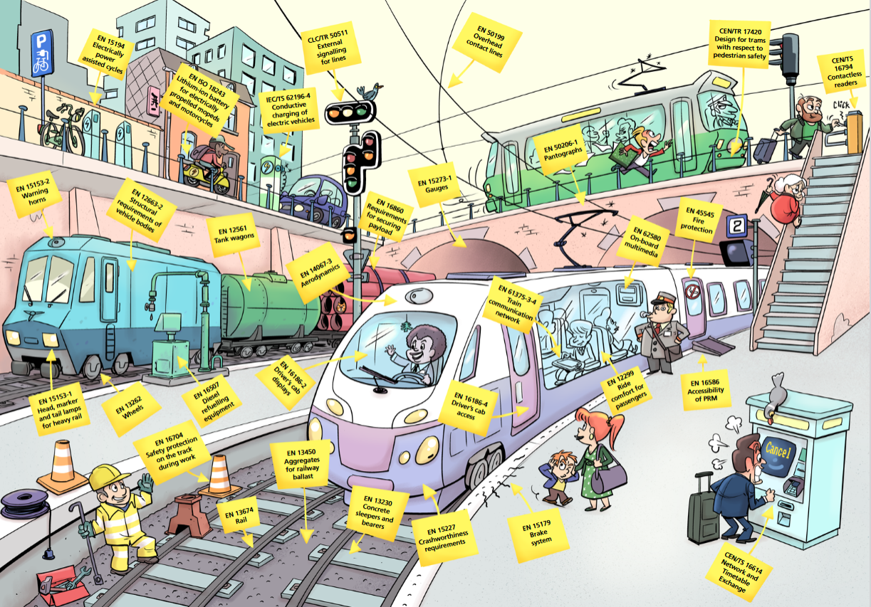
Standards in the mobility ecosystem
emobility
standards
Source: CEN-CENELEC

Slide 4
1. Regulatory framework conditions
Regulations and standards in the EU
Regulations and standards differ fundamentally:
Regulations are issued by governments or the EU and are legally binding.
Standards are voluntary documents representing best practices.
Despite this, there is frequent interaction between the two:
Regulations often reference standards.
The EU promotes standardization by issuing mandates to bodies like CEN and CENELEC.
This project has received funding from the European Union’s Horizon Europe research and innovation programme under grant agreement No 101135417. Additionally, this Work has received funding from the Swiss State Secretariat for Education, Research and Innovation (SERI) for its Associate Partner.

Slide 5
1. Regulatory framework conditions
New Approach
The EU’s “New Approach”
Legislation (regulations and directives) defines only essential requirements.
Technical details are provided by harmonized European standards.
These standards remain voluntary, but using them creates a presumption of conformity with legal requirements.
Example: The Low Voltage directive states:
  Measures of a technical nature shall be laid down (…), in order to ensure that persons and domestic animals are adequately protected against the danger of physical injury or other harm which might be caused by direct or indirect contact
Concordance with directive: annex ZZ of the harmonized EN standard
This project has received funding from the European Union’s Horizon Europe research and innovation programme under grant agreement No 101135417. Additionally, this Work has received funding from the Swiss State Secretariat for Education, Research and Innovation (SERI) for its Associate Partner.

Slide 6
1. Regulatory framework conditions
New Approach
“New Approach” is broadly applied
Low Voltage directive, Machine directive, etc.
NOT for vehicle type approval
UNECE regulations
UN level
This project has received funding from the European Union’s Horizon Europe research and innovation programme under grant agreement No 101135417. Additionally, this Work has received funding from the Swiss State Secretariat for Education, Research and Innovation (SERI) for its Associate Partner.

Slide 7
1. Regulatory framework conditions
New Approach
Relevant EU regulations for swappable battery systems include:
  Battery Regulation (EU) 2023/1542
  Alternative Fuel Infrastructure Regulation (EU) 2023/1804
  Regulation (EU) 168/2013 on two-/three-wheel vehicles and quadricycles
This project has received funding from the European Union’s Horizon Europe research and innovation programme under grant agreement No 101135417. Additionally, this Work has received funding from the Swiss State Secretariat for Education, Research and Innovation (SERI) for its Associate Partner.

Slide 8
2. State of the art
Product safety, security, liability
A comprehensive set of standards ensures trusted safety and security across the entire ecosystem.
This includes:
  Data exchange within the system
  Interfaces with external parties
Standards ensure a uniform level of safety and security for all components.
System-level risks arising from combining elements are already addressed through standard requirements.
Standards help clearly assign responsibilities and liabilities among stakeholders.
A defined state-of-the-art further supports legal clarity and technical accountability.
This project has received funding from the European Union’s Horizon Europe research and innovation programme under grant agreement No 101135417. Additionally, this Work has received funding from the Swiss State Secretariat for Education, Research and Innovation (SERI) for its Associate Partner.

Slide 9
2. State of the art
Product compliance
CEN-CENELEC’s principle of standards’ “verifiability”.
Ensures that compliance can be assessed objectively.
Users benefit from increased trust in quality and performance of standardized products.
Verified compliance provides assurance and supports market confidence
The standard compliance as “quality label”!
This project has received funding from the European Union’s Horizon Europe research and innovation programme under grant agreement No 101135417. Additionally, this Work has received funding from the Swiss State Secretariat for Education, Research and Innovation (SERI) for its Associate Partner.

Slide 10
2. State of the art
Harmonization and reference
Referencing or harmonizing standards in EU regulations supports implementation of swappable battery systems.
Relevant EU regulations:
Regulation (EU) 2023/1542 – on batteries and waste batteries
  Standardized swappable batteries could reshape battery type definitions.
  Compliance with standards might serve as sole classification criteria.
Regulation (EU) 2023/1804 – on alternative fuels infrastructure
  Should reference standardized battery swapping stations.
  Include minimum density requirements for fair infrastructure coverage.
Regulation (EU) No 168/2013 – on vehicle type approval
  Standards enable type approval of vehicles without fixed batteries.
  Helps maintain vehicle approval across different standardized battery options.
This project has received funding from the European Union’s Horizon Europe research and innovation programme under grant agreement No 101135417. Additionally, this Work has received funding from the Swiss State Secretariat for Education, Research and Innovation (SERI) for its Associate Partner.

Slide 11
3. State of the art standardization
IEC 62840 standard
IEC 62840 series: Electric vehicle battery swap system
Drafted by IEC TC69 WG13 (CN lead)
Part 1: "General and guidance" (2025) provides:
An overview of battery exchange systems for electric road vehicles.
System concepts and key use cases.
Differentiates between:
  Swappable battery systems (handled by the charging station; aimed at cars and heavy-duty vehicles).
  Removable battery systems (manually handled; aimed at light vehicles like those in the project).
Describes typical system components for both types.
This project has received funding from the European Union’s Horizon Europe research and innovation programme under grant agreement No 101135417. Additionally, this Work has received funding from the Swiss State Secretariat for Education, Research and Innovation (SERI) for its Associate Partner.

Slide 12
3. State of the art standardization
IEC 62840 standard
Part 2: "Safety requirements" (2016, second edition 2025):
Covers general safety requirements for both swappable and removable battery systems.
Systems must be reliably designed and constructed to:
  Ensure safe performance under normal use.
  Minimize risks to people, equipment, and the environment
This project has received funding from the European Union’s Horizon Europe research and innovation programme under grant agreement No 101135417. Additionally, this Work has received funding from the Swiss State Secretariat for Education, Research and Innovation (SERI) for its Associate Partner.

Slide 13
3. State of the art standardization
IEC 62840 standard
Part 3: “Particular safety and interoperability requirements for battery swap systems operating with removable RESS/battery systems”
Initially published as a PAS (Publicly Available Specification) based on IEC 61851-3 draft.
Currently being revised to be fully integrated into the IEC 62840 series. Provides:
Specific requirements and for handheld swappable battery systems (HBS).
Extends Parts 1 and 2 with application-specific provisions.
Applies to partly or fully electric vehicles using removable RESS/battery systems.
This project has received funding from the European Union’s Horizon Europe research and innovation programme under grant agreement No 101135417. Additionally, this Work has received funding from the Swiss State Secretariat for Education, Research and Innovation (SERI) for its Associate Partner.

Slide 14
3. State of the art standardization
Additional standards
Other relevant standards for battery swapping systems:
IEC TC21 and SC21A: Focus on battery safety.
IEC SC23H: Covers accessories such as connectors.
OCA consortium standards (e.g., OCPP protocol):
OCPP 2.0.1 → adopted as IEC 63584.
OCPP 2.1 (includes battery swap) is under development as an IEC standard.
Additional standardization activities
A new CEN TC301 WG19 focuses on swappable battery systems for L-category vehicles
(e.g., small/light vehicles).
Vehicle-side standardization is crucial for interoperability across brands and models.
This project has received funding from the European Union’s Horizon Europe research and innovation programme under grant agreement No 101135417. Additionally, this Work has received funding from the Swiss State Secretariat for Education, Research and Innovation (SERI) for its Associate Partner.

Slide 15
4. Strategies for mobility-related standardization
Fundamental recommendations
The ideal standardization work
  Interacting with regulatory needs
  Responding to societal needs
  Following technological progress, enabling but not impeding
  No overstandardization
This project has received funding from the European Union’s Horizon Europe research and innovation programme under grant agreement No 101135417. Additionally, this Work has received funding from the Swiss State Secretariat for Education, Research and Innovation (SERI) for its Associate Partner.

Slide 16
4. Strategies for mobility-related standardization
The case of swappable batteries
Standardizing swappable batteries:
  Shall be multi-brand, multi-model standard!
  Impact on vehicle design and brand identity, especially for smaller vehicles.
  The standardization process is slow (typically ≥3 years from proposal to publication).
This project has received funding from the European Union’s Horizon Europe research and innovation programme under grant agreement No 101135417. Additionally, this Work has received funding from the Swiss State Secretariat for Education, Research and Innovation (SERI) for its Associate Partner.

Slide 17
4. Strategies for mobility-related standardization
The case of swappable batteries
Why is the standardization process so slow?
This is due to its consensus-based, democratic nature, including:
  Democratic, consensus-based process
  Multiple commenting rounds: NP, CD, CDV, FDIS
  Participation from all interested national committees
  Active stakeholder involvement across sectors
This “weakness” is actually a strength!
Despite the pace, this process ensures high-quality, broadly accepted standards.
This project has received funding from the European Union’s Horizon Europe research and innovation programme under grant agreement No 101135417. Additionally, this Work has received funding from the Swiss State Secretariat for Education, Research and Innovation (SERI) for its Associate Partner.

Slide 18
4. Strategies for mobility-related standardization
“performance principle” and “aim-oriented approach”
Freedom of Choice in Technical Solutions
Standards should focus on performance targets rather than prescribing specific technologies.
Explicit solutions should only be mandated where needed to ensure interoperability (e.g. interfaces and connectors).
Allows supplier diversity and promotes market competition.
Support for Technological Progress
Standards should follow an "aim-oriented" approach, allowing flexibility and evolution.
Ensures components can be designed with forward/backward compatibility in mind.
Facilitates continuous improvement while maintaining system compatibility.
No restrictive standards stifling technological progress
This project has received funding from the European Union’s Horizon Europe research and innovation programme under grant agreement No 101135417. Additionally, this Work has received funding from the Swiss State Secretariat for Education, Research and Innovation (SERI) for its Associate Partner.

Slide 19
4. Strategies for mobility-related standardization
“performance principle” and “aim-oriented approach”
Simultaneous Participation of Multiple Actors
Standards enable interoperability among products and services from different suppliers.
Encourages parallel development:
  OEMs can develop vehicles without waiting for batteries or stations.
  Battery manufacturers can proceed independently as well.
  Helps overcome the “chicken and egg” problem, accelerating market deployment.
Scalability and Ecosystem Extension
Standards provide a framework for expansion and virtual modeling of ecosystems.
Support use cases beyond light vehicles.
Allow creation of additional ecosystems (public or private) with multiple suppliers, benefiting
from economies of scale.
This project has received funding from the European Union’s Horizon Europe research and innovation programme under grant agreement No 101135417. Additionally, this Work has received funding from the Swiss State Secretariat for Education, Research and Innovation (SERI) for its Associate Partner.

Slide 20
Case study
Development of the IEC 62840 Standards Series
Background and framework conditions
Initiated in 2012 by China State Grid, Better Place (Israel), and Renault (France)
Market Driver: Rapid EV market growth since 2010, with battery swapping emerging as a quick charging alternative
Technical Need: Uniform interfaces, communication protocols, and safety standards to prevent market fragmentation
Application Focus: Initially for commercial vehicles, later expanded to two-wheelers (post-2018) in China, Japan, Europe, and Southeast Asia
Policy Support: Government backing for battery-swapping technology, especially in electric heavy-duty vehicles
Global Collaboration: IEC partnership with ISO and national committees for worldwide applicability
This project has received funding from the European Union’s Horizon Europe research and innovation programme under grant agreement No 101135417. Additionally, this Work has received funding from the Swiss State Secretariat for Education, Research and Innovation (SERI) for its Associate Partner.

Slide 21
Case study
Development of the IEC 62840 Standards Series
Development success factors
International Collaboration: Global experts and companies from China, Japan, Germany, France, Israel, South Korea, and Indonesia participated in standard development
Structured Process: IEC's multi-stage approach (proposal → draft → voting → release) ensured iterative feedback and technical rigor
Progressive Development: Started with safety and system architecture, gradually transitioning to interoperability requirements
Standards Coordination: Alignment with related standards like IEC 61851-3 for consistency across the EV ecosystem
Broad Industry Engagement: Active participation from various stakeholders fostered consensus and global applicability
This project has received funding from the European Union’s Horizon Europe research and innovation programme under grant agreement No 101135417. Additionally, this Work has received funding from the Swiss State Secretariat for Education, Research and Innovation (SERI) for its Associate Partner.

Slide 22
Case study
Development of the IEC 62840 Standards Series
Challenges & Solutions
Technical Complexity
  Challenge: Diverse components (batteries, swap stations, interfaces) requiring robust safety standards
  Solution: IEC 62840-1 for general guidance + IEC 62840-2 for specific safety requirements
Global Applicability & Industry Alignment
  Challenge: Regional regulation variations and differing manufacturer interests
  Solution: Flexible standards allowing local adaptations while maintaining core requirements
Evolving Technology
  Challenge: Rapid EV and battery technology advancements
  Solution: Adaptable standards that adjust technical direction based on market developments
This project has received funding from the European Union’s Horizon Europe research and innovation programme under grant agreement No 101135417. Additionally, this Work has received funding from the Swiss State Secretariat for Education, Research and Innovation (SERI) for its Associate Partner.

Slide 23
Case study
Development of the IEC 62840 Standards Series
Key Lessons Learned
Early Industry Participation Critical: Better Place's bankruptcy in 2013 significantly impacted standardization development, highlighting the importance of diverse industry backing
Balancing Global vs. Local Needs: Regional differences and expert disagreements consumed significant time in the standard-setting process
Technology Uncertainty Impact: Complex and high-cost battery-swap technology development, especially for passenger vehicles, made standardization challenging
Sunk Costs Effect: Companies' early investments created barriers to achieving interoperability requirements, even after meeting safety standards
Market Evolution: Standards needed to adapt from focus on four-wheel passenger vehicles to include widespread low-voltage two-wheel platforms
The standardization journey demonstrates the complex interplay between
technology development, market forces, and regulatory frameworks
This project has received funding from the European Union’s Horizon Europe research and innovation programme under grant agreement No 101135417. Additionally, this Work has received funding from the Swiss State Secretariat for Education, Research and Innovation (SERI) for its Associate Partner.

Slide 24
5. Summary
Achievements
You now have a solid overview of:
Regulations and standards - The “New Approach”
The IEC 62840 standard series and its development process
Related standards
Why they matter for technology, markets, and society
Thank you for your attention!
This project has received funding from the European Union’s Horizon Europe research and innovation programme under grant agreement No 101135417. Additionally, this Work has received funding from the Swiss State Secretariat for Education, Research and Innovation (SERI) for its Associate Partner.

