Slide 1

Standardization and standards for mobility and transport in the ecosystem of swappable batteries
- Basic topics -
Prof. Dr. Knut Blind
Fraunhofer ISI

Slide 2
Learning objectives
Acquiring fundamental knowledge of standards
Understanding the effects of standards
Exploring the connections between research and development and standardization
Identifying the various roles of different standards
Understanding the impacts of standards for appropriate use

Slide 3

1. Basics of standards
What standards are (in a wide sense) and why they’re needed
The most general definition for a «standard» may be
«a widely agreed way of doing something» ...
... where, depending on the specific area of application, “doing something” may be replaced by, e.g., “designing a product”, “building a process”, “implementing a procedure” or “delivering a service”.
«Standard» (i.e. agreed and common) ways of doing things bring lot of benefits; our technological world without «standards» simply would not work (or, at least, it would be much harder to make it work)
© ETSI. All rights reserved

Slide 4
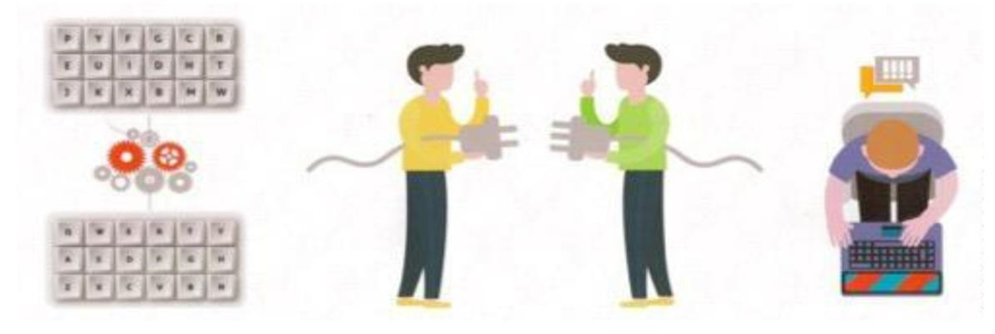

1. Basics of standards
What standards are (in a wide sense) and why they’re needed
For instance, what if
each computer had its own type of keyboard
each smartphone and PC had its own specific set of connectors and charger (though some have by choice… more on this later)
each device had its own protocol for interoperation
© ETSI. All rights reserved

Slide 5
1. Basics of standards
Formal standardisation, SDO standards, and regulation
Standards are NOT regulations
Compliance with standards is voluntary; regulations are mandatory.
Non-compliance with regulations restricts market access;
non-compliance with standards does not.
Example: Some smartphones with proprietary connectors.
Standards can be incorporated into regulations to simplify regulatory processes.
Standards are NOT detailed design rules
They define a minimum set of requirements to achieve specific goals (e.g., interoperability, performance).
Many ‘standard-compliant’ implementations are possible
© ETSI. All rights reserved

Slide 6

1. Basics of standards
Two main different types of “standards”
De facto standards, or standards in actuality, are adopted widely by an industry and its customers. These standards arise when a critical mass simply likes them well enough to collectively use them.
SDO standards are produced by devoted organizations, called Standards Development Organizations (SDOs). SDOs are organizations whose main purpose is to develop standards. They have that put in place formal well-defined procedures to guarantee a fair development process.
De facto standards can become formal standards if they are approved by an SDO. Examples: HTML, PDF
Figures: © ETSI. All rights reserved

Slide 7
1. Basics of standards
Formal standardisation, SDO standards, and regulation
A standard must be clear and unambiguous.
It should help readers understand what is essential for compliance.
It must clearly distinguish between:
Normative parts: mandatory requirements for compliance.
Informative parts: for conceptual understanding.
It should be written in plain language, using simple and short sentences.
Requirements must be consistent, testable, and non-redundant.
Objectives should be well-defined and address real needs.
It should avoid unnecessary over-prescriptiveness.

Slide 8
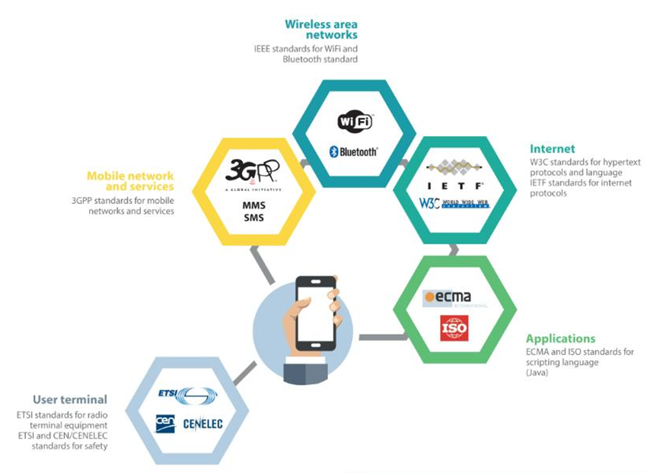
1. Basics of standards
Standards in everyday life
Using a Smartphone for browsing
(some probably deployed standards):
  User equipment, e.g. hardware characteristics and safety/security aspects
  Connectivity between user devices and wireless network, functionality of this network
  Internet access and the protocols to support web browsing
© ETSI. All rights reserved

Slide 9

1. Basics of standards
Standards in everyday life
A typical laptop uses over 500 standards.
251 technical interoperability standards were identified in a 2010 study (Biddle et al.).
80% of these were developed by Standards Development Organizations (SDOs).
20% came from individual companies.
© ETSI. All rights reserved

Slide 10
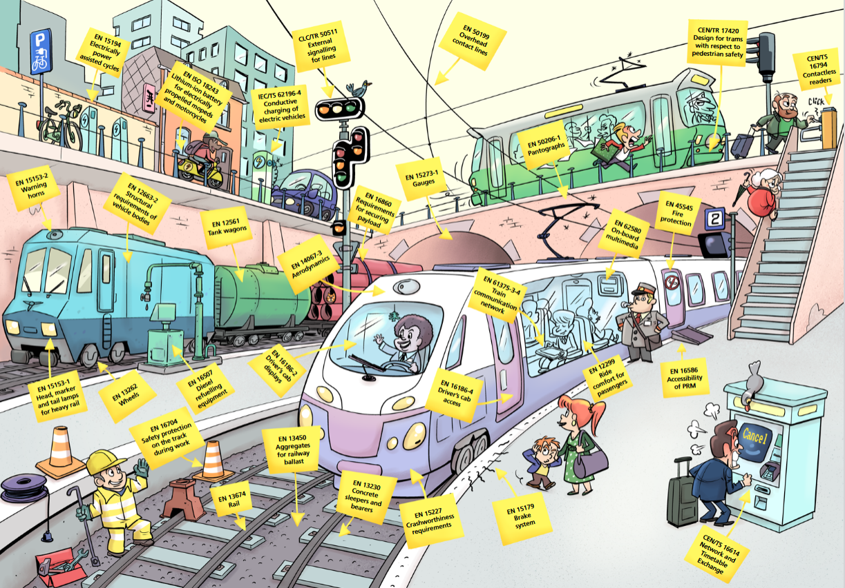
1. Basics of standards
Standards in the mobility ecosystem
3 emobility
standards
Source: CEN CENELEC

Slide 11
1. Basics of standardisation
Formal standardisation, SDO standards, and regulation
Identify needs
Define scope and work plan
Elaborate new
or revised standards
INCEPTION CONCEPTION DRAFTING
OBSOL-ESCENCE
APPROVAL
Obsolete superseded standards
Official issue
or revised standards
OBSOLETE APPROVED
© ETSI. All rights reserved

Slide 12
2. Effects of standards
Overview
 | Positive Effects | Negative Effects
Compatibility/ Interface Standards | Network externalities, like enabling seamless global communication Avoiding lock-in in old technologies Increased variety of system products Efficiency in supply chains | Anti-competition, leading to monopoly Lock-in in old technologies in case of strong network externalities
Minimum Quality/ Safety Standards | Avoiding adverse selection, i.e. supply of bad quality drives out good quality Creating trust Reducing transaction costs | Regulatory capture Increasing barriers to entry
Variety Reduction Standards | Economies of scale Building focus and critical mass | Reduced choice Leading to monopoly, barriers to market access
Information/ Measurement Standard | Facilitating trade Reduced transaction costs Providing codified knowledge | Regulatory Capture
Source: Swann (2000), Pham (2006), Blind (2013), modified

Slide 13
2. Effects of standards
Compatibility and Interface Standards
Compatibility is a core function of standards.
According to ISO 25010, compatibility includes:
  Coexistence: Systems share resources without conflict.
  Interoperability: Systems work together effectively.
In the ICT sector, compatibility and interfaces have strong economic significance.
Two key economic influences:
  Network effects: Value increases with more users.
  Switching costs: Costs of changing systems/products.
When both are present, there is a risk of a lock-in effect (users become dependent on a specific system).

Slide 14

2. Effects of standards
Compatibility and Interface Standards
Network effects – two forms:
  Direct: The value of a good/ services increases with the number of people using it
  Examples: Telephone, e-mail, Facebook, X, …
  Indirect: The value of a good/service does not depend directly on the number of users but rather on the availability of complementary and compatible components
  Examples: Video game consoles, computer hardware and software, …
Source: Greenstein and Stango (2008)

Slide 15
2. Effects of standards
Compatibility and Interface Standards
Switching costs:
Once producers or customers have invested into a particular interface or standard, switching to another one will become increasingly expensive
Examples:
  Acquisition costs: When new equipment has to be bought or adapted
  Training costs: Associated with learning to use a new product
  Testing costs: If there is uncertainty regarding the suitability of alternative products/services
Source: Parr et al. (2005)

Slide 16

2. Effects of standards
Compatibility and Interface Standards
Lock-in occurs when markets or users remain tied to inferior technologies.
Switching only happens if:
  Everyone else switches, and
  Switching costs are affordable.
If either condition isn't met, lock-in persists.
Lock-in is more likely when:
  A standard is not formally standardized, and
  It is controlled by a single organization.
Market consequences of lock-in include:
  Barriers to entry
  Monopoly formation
Source: Parr et al. (2005), de Vries et al. (2008)

Slide 17
2. Effects of standards
Compatibility and Interface Standards
Open standards have positive market effects.
A standard is considered open based on the openness of the standardization process.
In an open process, anyone (individuals or organizations) can participate.
The result is an open standard.
Formal processes should follow WTO principles:
  Transparency, openness, impartiality, consensus, efficiency, relevance, and consistency.
Open standards reduce lock-in risks by:
  Being accessible and widely implementable
  Lowering barriers to entry and switching costs for consumers.

Slide 18
2. Effects of standards
Compatibility and Interface Standards
Compatibility standards reduce transaction costs by minimizing the need for buyers
to verify interoperability (e.g., software with an OS).
Lower transaction costs enable greater division of labour.
Example:
  Computers use globally sourced components.
  International compatibility standards have globalized the industry.
  Producers can specialize in specific value chain segments,
  gaining economies of scale and accessing global markets.

Slide 19
2. Effects of standards
Minimum Quality and Safety Standards
Minimum quality standards set baseline requirements
for reliability, durability, safety, and other areas (e.g. working conditions).
They can enhance welfare, including health and environmental outcomes.
Help reduce buyer risk and build trust in trade between traders.
If set too high, they may become barriers to market entry.
When adopted by regulation (e.g., CO₂ emission limits for cars), compliance becomes legally mandatory.
Source: based on Swinnen (2015) and Locksley (1990)

Slide 20

2. Effects of standards
Minimum Quality and Safety Standards
Customers struggle to choose among many product variants.
If buyers can’t assess quality,
high-quality sellers can't justify higher prices.
This can lead to Gresham’s law: “Bad drives out the good.”
Worst case: Market may fail completely
due to lack of trust in product quality.
© ETSI. All rights reserved

Slide 21

2. Effects of standards
Minimum Quality and Safety Standards
The issue stems from information asymmetries,
where sellers know more than buyers.
This makes it difficult for buyers to make informed decisions.
Leland (1979) showed that minimum quality standards
can reduce these asymmetries by setting clear baseline requirements.
Some firms rely on their reputation to justify higher prices
by offering quality well above the standard.
Ex-post restitution (e.g., guarantees) can also substitute
for formal quality standards.
© ETSI. All rights reserved

Slide 22
2. Effects of standards
Minimum Quality and Safety Standards
Minimum quality standards reduce transaction and search costs caused by economic exchange
If a product is defined in a way that reduces buyer uncertainty:
  The buyer’s risk is reduced
  Less need for the buyer to spend money and time on evaluating different products before a purchase
Product certification can function as a shortcut for buyers as it proofs the compliance to a standard
Source: Pham (2006); Swann (2000); Swann (2010)

Slide 23
2. Effects of standards
Minimum Quality and Safety Standards
Minimum quality standards can help level the playing field between new entrants and incumbents
by clearly defining product requirements.
Without standards, incumbents hold an information advantage.
However, standards set too high can act as entry barriers.
Even if costly for incumbents, such standards may burden entrants more,
effectively raising rivals’ costs.
This strategy can lead to “regulatory capture”, where producers influence regulators
to shape standards in their own interest - rather than in that of consumers.

Slide 24
2. Effects of standards
Variety Reduction Standards
Two main functions:
  Support of economies of scale, by minimizing the proliferation of minimally differentiated models
  Reduction of transaction costs for customers, because they do not have to choose between a vast number of slightly different products
Many advantages:
  Prevention of market fragmentation and support of a joint vision
  For suppliers, less fragmentation also means reduced risk
  Variety reduction standards can also reduce barriers to entry
    Variety proliferation is sometimes used by incumbents to limit competition from small scale entrants who cannot provide the same degree of variety
    Some incumbents try to restrict entry by companies with an idiosyncratic product specification

Slide 25
2. Effects of standards
Variety Reduction Standards
Do variety reduction standards need to be defined publicly?
  Not necessarily: Economies of scale (best-known function of this type of standard) can also be obtained with an idiosyncratic model range
  But: A store selling cloth in idiosyncratic sizes will not perform well

Slide 26

2. Effects of standards
Information and Measurement Standard
Information and measurement standards: Standards that contain codified knowledge and product descriptions
These standards an be seen as important instruments of technology transfer as they…
  …contain the work and experience of generations
  …act as instruments in the dissemination of best practices
© ETSI. All rights reserved

Slide 27

2. Effects of standards
Information and Measurement Standard
Information and measurement standards have a positive effect on the market by disseminating knowledge. They support
  …building up competencies
  …spreading essential production knowledge, thus levelling the playing field for incumbents and entrants
  …reducing information asymmetries
  …reducing barriers to market entry
These standards lower transaction costs between companies and contractors, e.g. employees, suppliers and customers, by providing a common language and therefore…
  …ease the writing of job descriptions, contracts etc.
  …achieve a feasible division of labour
© ETSI. All rights reserved

Slide 28

2. Effects of standards
Example: Digital Image compression
1990s saw rapid growth in image/video processing and multimedia technologies.
This drove demand for efficient compression methods.
International SDOs developed key standards like JPEG (Joint Photographic Experts Group).
These standards enabled reduced storage needs and lower transmission rates.
Widely used in applications such as:
  Digital image sharing
  Remote sensing
  Archiving
  Image search
Source picture: Schelkens (2015)

Slide 29
3. Standard development organisations
De facto standards vs SDO standards (Blind 2008)
SDO STANDARD | DE FACTO STANDARD
Developed in SDOs Open and consensus oriented with the option of opposition, which may sometimes lead to lengthy decision procedures Clear and transparent participation and voting rules | Dominant design through a standard war or natural selection. A company achieves a dominant position by public acceptance or market forces, e.g. Windows Standardisation process with restricted access; homogeneous environment may allow fast decisions Direct participation of company alliances (e.g. consortia) and individual companies

Slide 30











3. Standard development organisations
Classification of SDOs
International SDOs
  These have members worldwide, which sometimes also include national or regional standard bodies, and their deliverables have worldwide coverage.
Regional SDOs
  These have members (industries, academia and national SDOs) from well defined geographic regions that usually share, or are interested in promoting common practices and regulations.

Slide 31
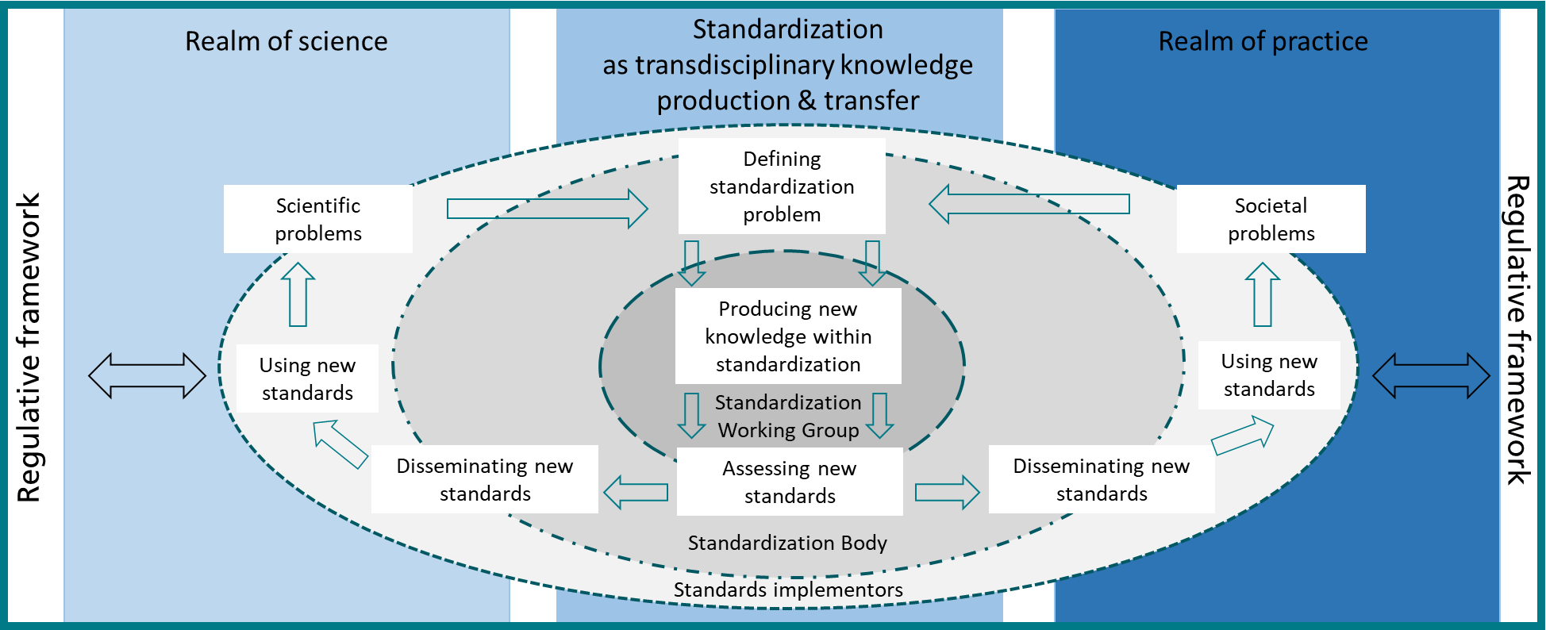
4. Interlinkages between R&D and standardisation:
Standardisation as transdisciplinary knowledge production & transfer
Source: Blind 2004
Notes:
31

Slide 32
4. Interlinkages between R&D and standardisation:
A Recursive Model of Research and Standardisation
Source: Blind and Gauch 2009
Notes:
32

Slide 33
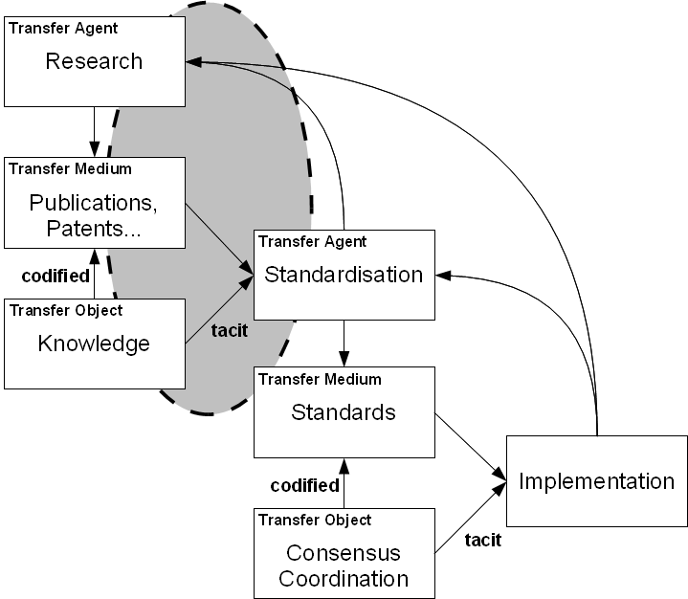
4. Interlinkages between R&D and standardisation:
A Cascading Knowledge Transfer Model
Source: Blind and Gauch 2009
Notes:
33

Slide 34
5. Various roles of different types of standards
In the research and innovation process
Source: Blind and Gauch 2009

Slide 35
6. Impacts of standards
On research and innovation
General functions of standards | Positive impacts on research and innovation | Negative impacts on research and innovation
Information | Provide codified knowledge relevant for innovation Coordinate collaborative innovation activities | Generate cost for standards screening Allow unintended knowledge spillovers to competitors by implementation of standards
Variety reduction | Allow exploitation of economies of scale via standards Support critical mass via standards in emerging technologies and industries Create incentives for incremental innovation based on standards | Reduce choice Support market concentration Push premature selection of technologies Limit incentives for radical innovation
Minimum quality | Creating trust in innovative technologies and products at the demand side | Promote market concentration
Compatibility | Increase variety of system products Promote positive network externalities Avoid lock-in into old technologies | Push monopoly power Foster lock-in into old technologies in case of strong network externalities
Insurance | Serve as insurance against failure of radical innovation | Create incentives for incremental instead of radical innovation
Source: Blind 2022 edited by ISO https://www.iso.org/publication/PUB100466.html

Slide 36
7. Future prospects
Achievements and next steps
You now have a solid overview of:
What standards are
Where they appear
Who develops them
Why they matter for technology, markets, and society
Thank you for your attention!
We look forward to welcoming you at our next presentation, where we’ll explore advanced topics in mobility standardization.

Slide 37
References 1
Biddle & al. (2010). How many standards in a Laptop? (and other empirical questions), http://ssrn.com/abstract=1619440
Blind, K. et al. (2022). The Interplay Between Product Innovation, Publishing, Patenting and Developing Standards. Research Policy, Vol. 51(7), 2022.
Blind, K. (2024). Standardization in the context of transdisciplinarity, Sustainability Science 19 (5), 1609-1621
CEN-CENELEC (no data). Standards@Rail. https://www.cencenelec.eu/media/CEN-CENELEC/News/Publications/standards-rail_cartoon.pdf
David, P. A. & W. E. Steinmueller (1994). Economics of compatibility standards and competition in telecommunication networks. Information Economics and Policy 6(3-4): 217-241.
ETSI (2020). A Guide to Writing World Class Standards, https://www.etsi.org/e-brochure/WritingWorldClassStandards/mobile/.
ETSI (2021). Understanding ICT Standardization: Principles and Practice 2nd edition.
https://www.etsi.org/images/files/Education/Textbook_Understanding_ICT_Standardization.pdf
ETSI (2023). ETSI Drafting Rules (EDRs). https://portal.etsi.org/Services/editHelp/How-to-start/ETSI-Drafting-Rules.
ETSI (2025). Standards making process, https://www.etsi.org/standards/standards-making.
ETSI (2025). Different types of ETSI Standards, https://www.etsi.org/standards/types-of-standards.
ETSI (2024). ETSI directives, https://portal.etsi.org/Resources/ETSI-Directives.
Fishman, G. (2012). Decision-Making and Approval Procedures: soft and hard decisions, https://www.itu.int/en/ITU-T/tutorials/Documents/201210/Session-06-Rapporteur%20Tutorial%201208G-Decision_Making.pdf
Foucart, R. & Q. C. Li (2021). The role of technology standards in product innovation: Theory and evidence from UK manufacturing firms, Research Policy 50(2), 104157.

Slide 38
References 2
Miotti, H. (2009). The Economic Impact of standardization: Technological Change, Standards Growth in France.
Moore, G. C., & Benbasat, I. (1991). Development of an instrument to measure the perceptions of adopting an information technology innovation. Information systems research, 2(3), 192–222.
Parr, A. N., Finbow, R. J., & Hughes, M. J. (2005). UK merger control: Law and practice (2nd ed.). London: Sweet & Maxwell.
Pham, T. H. (2006). Economic Aspects of Standardization. In W. Hesser (Ed.), Standardization in companies and markets (pp. 61–99). Hamburg: Helmut-Schmidt-Univ. [u.a.].
Raustiala, K., & Sprigman, C. J. (2012). The knockoff economy: How imitation sparks innovation. Oxford, New York: Oxford University Press.
Salop, S. C., & Scheffman, D. T. (1983). Raising Rivals' Costs. The American Economic Review, pp. 267–271.
Schelkens, P. (2015). JPEG Standards: Are we prepared for the next disruptive evolution in digital imaging markets?, June, 4.
Swann, G. M. P. (2000). The Economics of Standardization. Final Report for Standards and Technical Regulations Directorate Department of Trade and Industry. Manchester Business School. https://assets.publishing.service.gov.uk/media/5a790abd40f0b679c0a0812d/10-1135-economics-of-standardization-update.pdf. Accessed January 2025.
Swann, G. M. P. (2010). International Standards and Trade: A Review of the Empirical Literature, OECD Trade Policy Papers, No. 97, OECD Publishing, Paris, https://doi.org/10.1787/5kmdbg9xktwg-en
Swann, G. M. P., & Gill, J. (1993). Corporate vision and rapid technological change: The evolution of market structure. New York, N.Y: Routledge.
Swann, G. M. P., & Watts, T. (2002). Visualization needs vision: The pre-paradigmatic character of virtual reality. Virtual society, 41–60.
Swinnen, J. F. M. (2015). Quality standards, value chains, and international development: Economic and political theory.
Teubner et al. (2021). Industry consortia in mobile telecommunications standards setting: Purpose, organization and diversity, Telecommunications Policy, Volume 45, Issue 3, 102059, https://doi.org/10.1016/j.telpol.2020.102059.
Williamson, O. E. (1989). Transaction cost economics. Handbook of industrial organization, 1, 135–182.

